Slide 1
sex
Web Int Course
Spring Semester 2023-2024
ally
It's about time sex stops being a taboo topic.
Group members:
Alexandra Gkaragkani
Georgia Bantouva
Olga Lantzouraki
Eva Pantazi

Slide 2
Introduction Sexally is aimed to be an open platform and a safe environment where everyone can share their experiences, their misconceptions, their questions about any sex-related matter and be able to receive feedback both by experts and also by common users. It is so rare a teen and even an adult receives the proper sex education. We are ashamed to discuss it with our parents, ashamed with our friends, we cannot speak with our teachers at school, we usually don’t even have a sex education course. We should all know about safety, about STIs, about our body and our partner’s as well, about what the terms of sexuality, acceptance, consent and many more mean. We should all let aside the shame around it, for no reason, and start educating ourselves. The percentages, below, show how little importance we give to these crucial topics.
49%
81%
93%
Less than half of students learn enough about key issues like accessing local sexual health services
Young people ask for and support including consent in primary school
Queer students ages 13-21 report that school health classes often lack positive representations of LGBTQ-related topics.
Surveys: https://www.endviolenceagainstwomen.org.uk/young-people-learning-about-sex-from-porn-and-social-media-survey-finds/ & https://teenhealthms.org/blog/4-sex-education-stats-teens/

Slide 3
Purpose statement
Shameless. Safe. Inclusive. Informative.
Challenge taboos: Challenge society taboos and misconceptions around sexuality. Sex should not be a topic you are afraid to talk about.
Provide a safe space: Fill a crucial gap in sex education by creating a digital platform where individuals can engage in open, honest, and respectful conversations about sexuality without fear of judgment or stigma, by promoting inclusivity, diversity, and acceptance.
Encourage empowerment: Empower individuals to embrace their sexual identity, preferences, and desires and self-expression. Trust your boundaries, have confidence and respect for your body, consequently for yourself.
Foster education and awareness: Offer reliable resources, articles, and expert advice to educate and inform adults and also kids about various aspects of sexuality, including health, relationships, and pleasure.

Slide 4
Site Overview
Navigation: Use the menu at the top right to access the different sections provided.
Sections: Offers articles, quizzes, chatrooms, contact us and main page options.
Main Page: Start point for exploring content and returning. The main page includes a brief explanation of who we are, what is the purpose of the page, includes videos of users, who have used it and shared their experience, and the footer with clickable options to navigate as well.
Content: Articles cover various topics, quizzes test knowledge on different topics, chatrooms enable discussions with both experts and the rest of the users and finally, contact facilitates communication with the owners of the page.
Accessibility: Access sections from any page via the top menu or footer links.
Interaction: Engage with content, participate in discussions, seek assistance via contact options and chatrooms.
User-Friendly: Easy navigation, same layout across pages and colorful images.

Slide 5
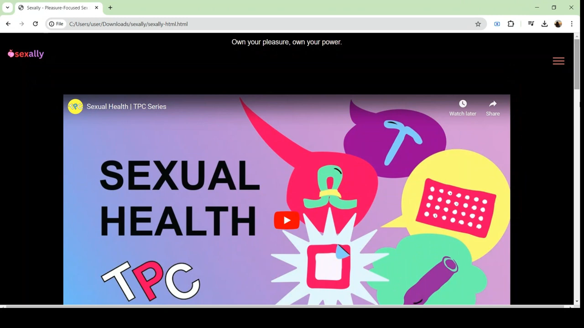

Slide 6
Bibliographical references
https://flo.health/
https://medium.com/
https://kidshealth.org/en/teens.html/
https://my.clevelandclinic.org/
https://www.whattoexpect.com/
https://www.plannedparenthood.org/
https://www.thesource.org/
https://www.verywellmind.com/
https://nedc.com.au/
https://rapecrisis.org.uk/
https://www.sexualrightsinitiative.org/
https://www.urmc.rochester.edu/
https://teenhealthsource.com/
https://www.coe.int/en/web/portal/home
https://www.proprofs.com/quiz-school/
https://medlineplus.gov/
https://www.w3schools.com/
https://www.geeksforgeeks.org/
https://www.codecademy.com/
https://chat.openai.com/

